Slide 1
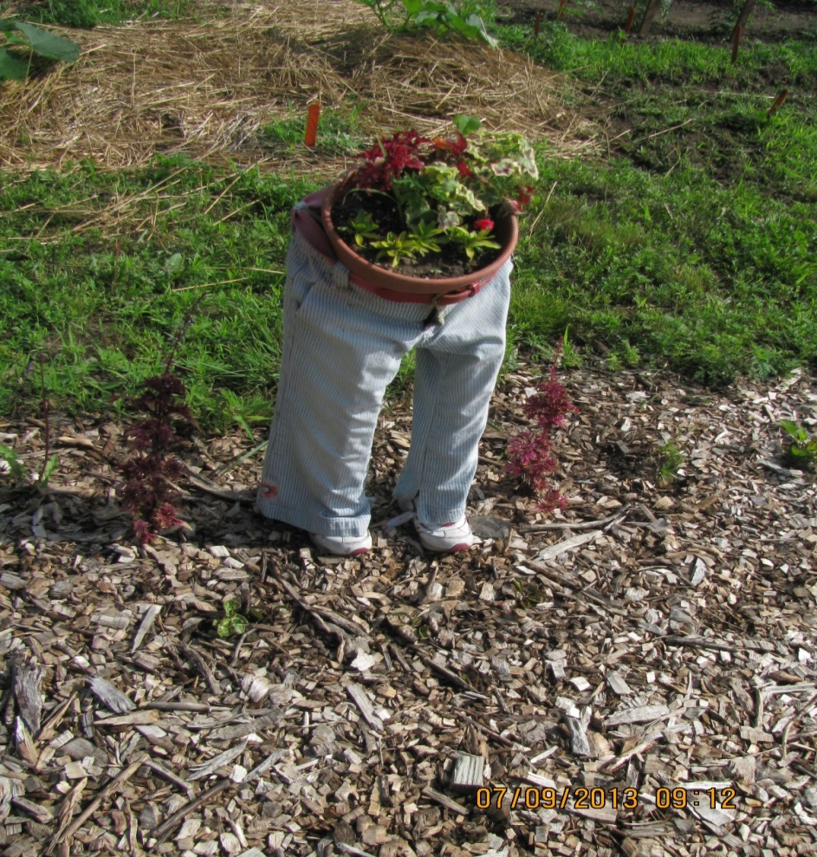
Secrets of the Soil with a Sense of Humus
Healthy Soils, Organic Matter & Natural Fertility
Jon Dahl, MSU Soil Testing Specialist

Slide 2
Overview - Basic Soils Concepts - Important Soil Properties - Organic Matter & Compost - Decomposition Process - Soil Testing - MSU Soil Test Report

Slide 3
What is the “Ideal” soil?
Consists of:
45% mineral matter
5% organic matter
25% water
25% air

Slide 4
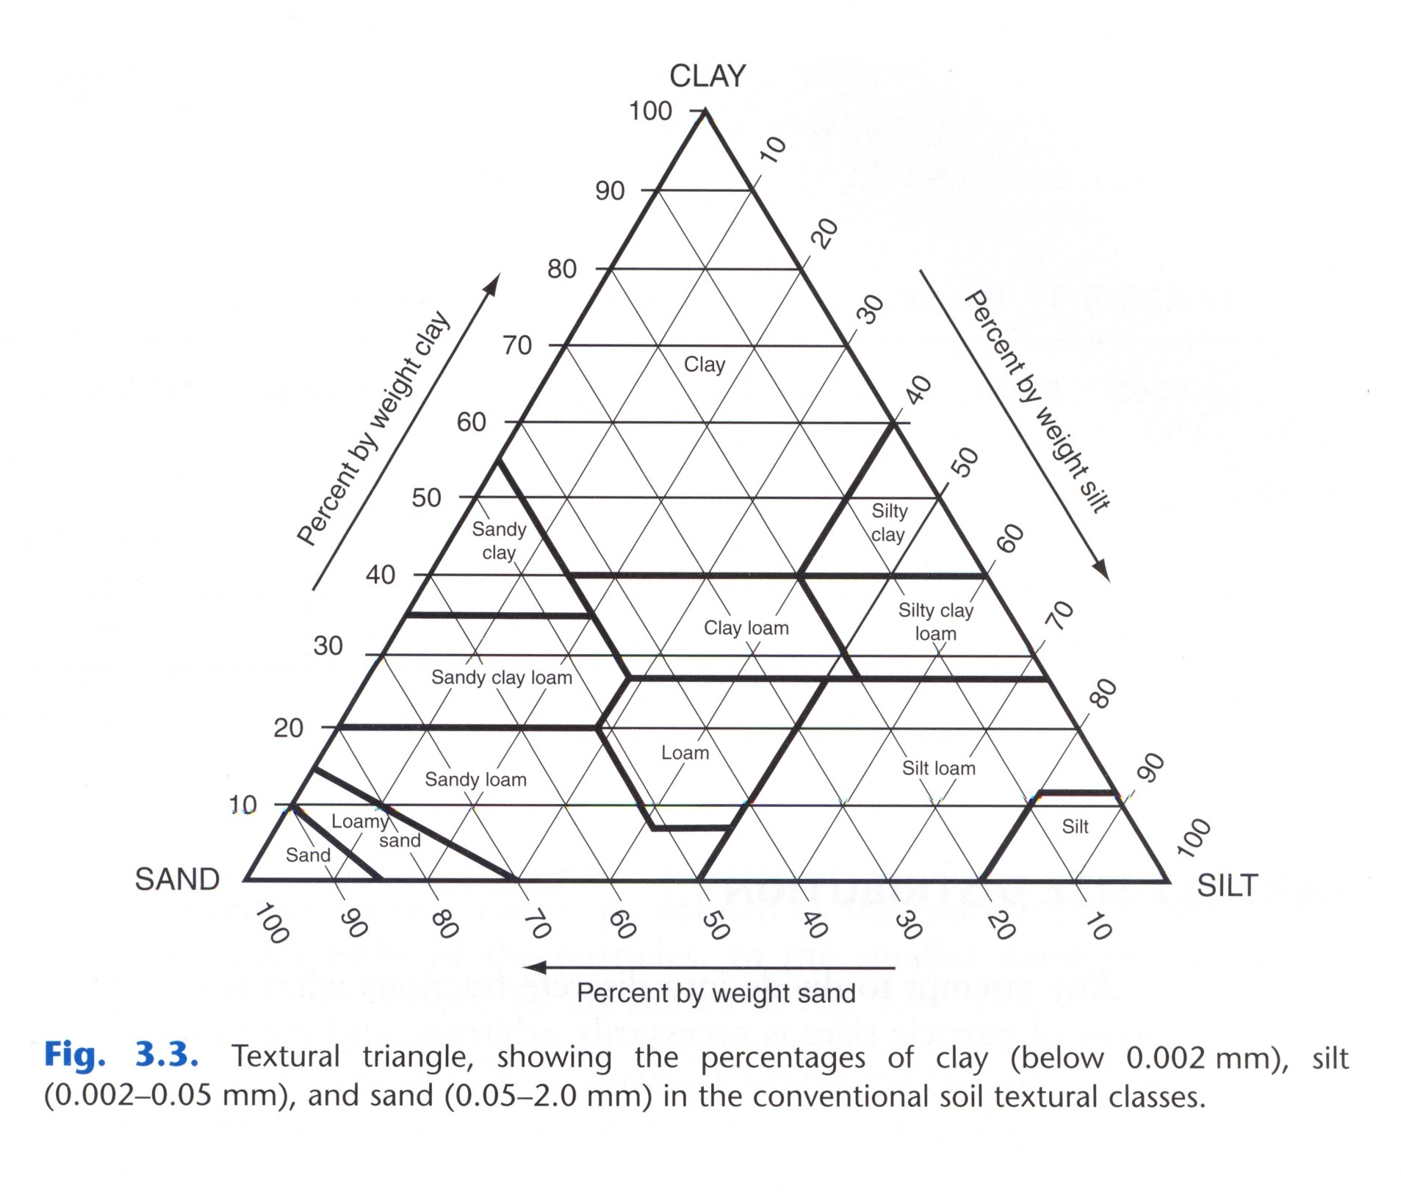

Slide 5
What if we don’t have the “Ideal” Loam Soil
Properties important for plant growth.

Slide 6
Soil Properties Important for Plant Growth
Soil aggregation/ structure
Water holding capacity
Organic matter
Soil pH
Available nutrient levels

Slide 7
Soil aggregation/structural types
Notes:
See description in text.

Slide 8
Soil Aggregation/Structure and Water Holding Capacity
How soil particles are held together.
Role of root exudates
Also improved by adding organic materials
Stimulates soil bacteria, worms and other organisms.
Essential for producing materials that will help bind soil particles together.

Slide 9
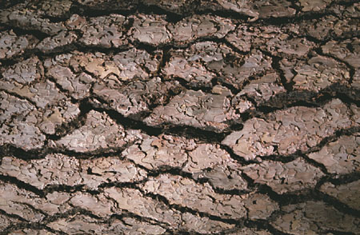
Texture vs. Structure
Texture is unchangeable
Structure can be improved or destroyed
Notes:
It is extremely important to note that texture is an unchangeable property of soil but structure can be improved or destroyed by human activity.
It is important for gardeners to manage the soil to improve and maintain soil structure. Remember, soil structure must be maintained. Adding organic matter once does not improve soil structure over an extended period of time. Organic matter must be added continuously. A poorly structured soil does not provide a desirable environment for plant growth.

Slide 10
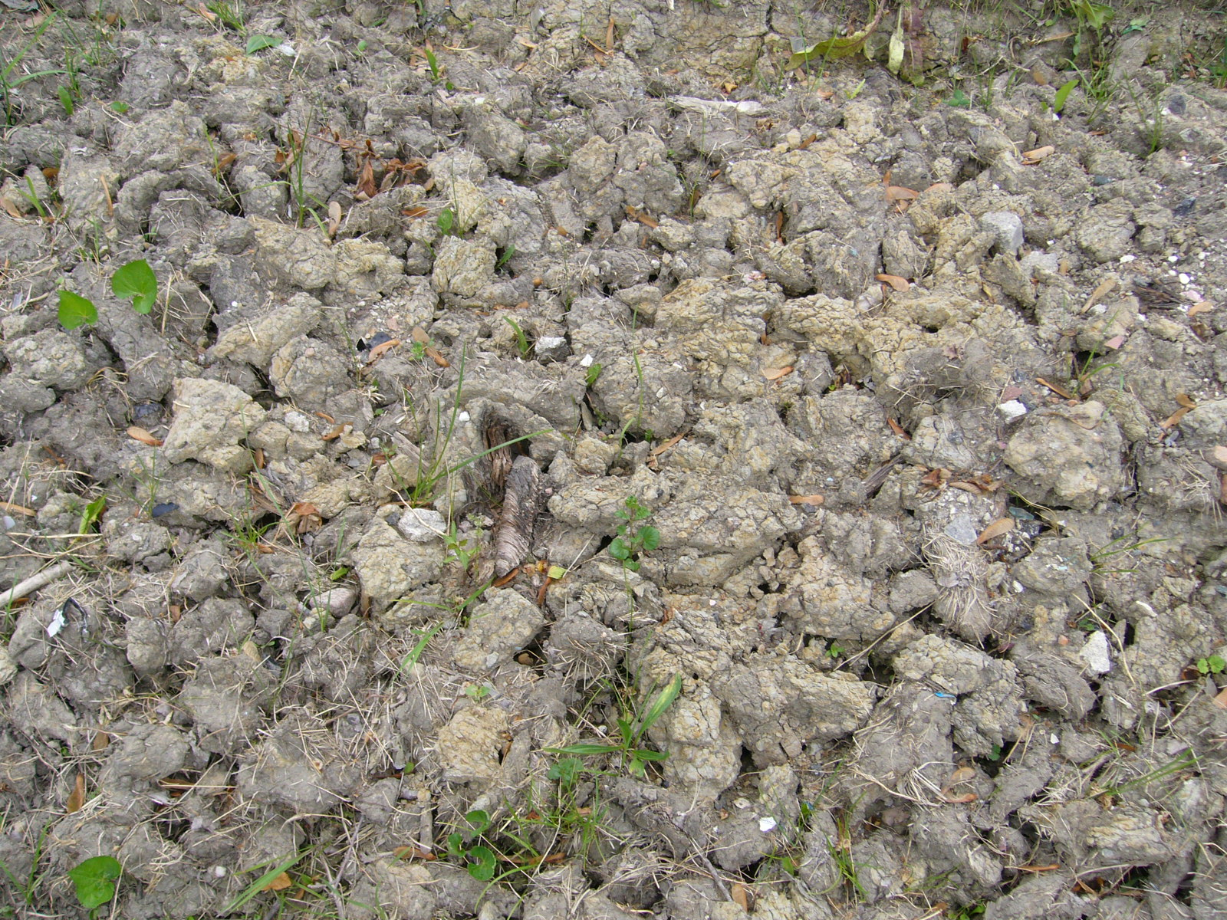
Example tilling soil when it is too wet: Even weeds don’t grow.
Notes:
Example of a new garden site that was tilled when it was too wet.

Slide 11
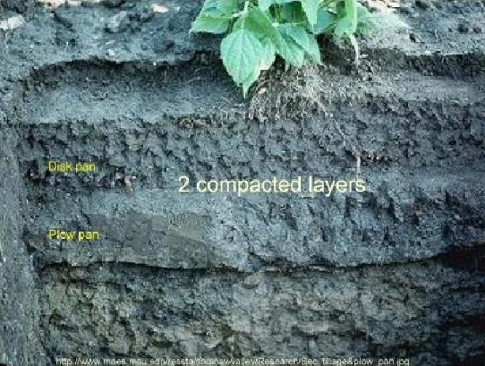
Compaction layers that can form in soil
Notes:
Figure 19 and 20

Slide 12
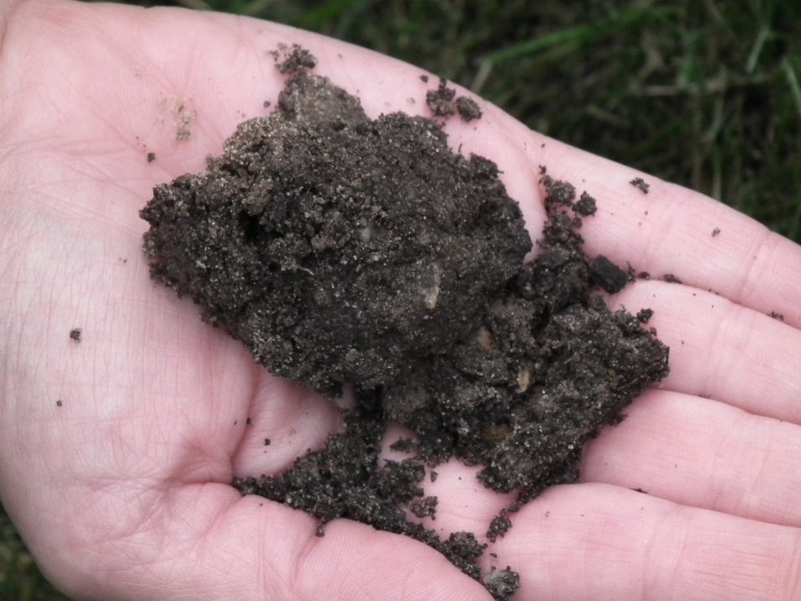
Tillage: Soil too wet to till Soil just right
Notes:
Figure 17 and 18

Slide 13
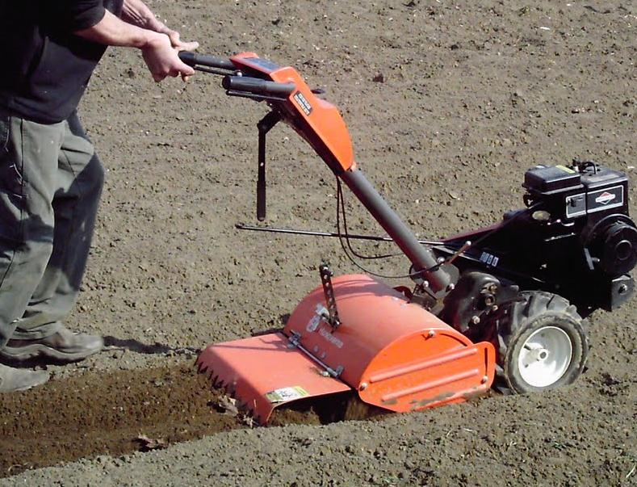
Don’t overdo it with the rototiller: limit the number of passes over the soil
Notes:
This soil is over-tilled

Slide 14
IMPROVING STRUCTURE
INCREASE & IMPROVE structure by adding organic matter
decay builds “tilth” (microbial gums)
Better structure reduces a soil’s harshest limitation inherent in its texture
sands gain micropores and are less droughty
clays gain macropores and are better aerated / drained
Roots penetrate easily, water and air move freely, tillage is easy
Notes:
Page 10 discusses microbial gums: Stress that it is not the organic matter itself that binds soil particles but rather the activity of microorgainisms feeding upon it.

Slide 15
Organic Matter
Produced as plant materials break down.
Regular compost addition greatly increases soil content.

Slide 16
Composts
Many different types:
Leaf, grass clipping, animal waste, etc.

Slide 17
What happens when you add compost to the soil?
Benefits of compost go well beyond the nutrient additions. Yearly additions begin to compound the benefits over time.

Slide 18
Total nutrient levels in 23 compost materials used by the MSU Student Organic Farm (Biernbaum)
 | N | P | K | CA | MG | NA | S
 | % | % | % | % | % | % | %
Low | 0.51 | 0.10 | 0.28 | 1.35 | 0.42 | 0.01 | 0.08
Average | 1.90 | 0.70 | 1.01 | 3.21 | 0.76 | 0.09 | 0.42
High | 3.53 | 4.15 | 2.37 | 7.40 | 1.51 | 0.52 | 2.76
 | FE | ZN | MN | CU | B | AL
 | ppm | ppm | ppm | ppm | ppm | ppm
Low | 5108 | 49 | 118 | 12 | 14 | 2183
Average | 7554 | 231 | 338 | 40 | 29 | 4838
High | 10350 | 1335 | 2212 | 161 | 64 | 8482

Slide 19
Nitrogen Phosphorus and Potassium Availability in Composts
Only 10 to 15% of nitrogen available the first year.
50 to 80% of phosphorus is available the first year
90% of potassium available the first year

Slide 20
Compost Addition
Inoculates soil with beneficial bacteria and fungi
Increases soil and plant health
Reduces the occurrence of root and foliar plant pathogens
Provide essential nutrients

Slide 21
Benefits of Mulching: Helps prevent compaction

Slide 22
Benefits of Mulching: Moisture retention

Slide 23
Benefits of Mulching
Weed suppression
Soil insulation
Nutrients

Slide 24
Meet the Decomposers

Slide 25
How does the Process of Decomposition Work?
Bacteria
Put down some organic matter and bacteria go to work
100 million to 1 billion per teaspoon of material
As much mass as 2 cows per acre

Slide 26
Bacteria enhance soil quality by:
Decomposing organic matter
Keep nutrients in the rooting zone
Enhance soil structure
Compete with disease causing organisms
Filter and degrade pollutants as water flows through soil

Slide 27
How do soil fungi operate in the decomposition process
Decompose more complex materials than do bacteria
Improve accumulation of organic matter
Retain nutrients
Bind soil particles into aggregates
Improve plant growth

Slide 28
Mycorrhizae
Plant provides access to food source
Extensive network of fine threads gather water and nutrients for the plant
Also important for disease and drought resistance

Slide 29
Mycorrhizae
Positive effect of mycorrhizae on root growth

Slide 30
Earthworms enhance soil quality by:
Shredding organic matter
Increase soil porosity and moisture holding capacity
Turn soil over
Create channels for root growth

Slide 31
Types of Mulch
Shredded leaves
Grass clippings
Pine needles for acid-loving
Compost: 1 to 3 inches
Straw
Shredded bark

Slide 32
Turning fall’s deposit into black gold!

Slide 33
Benefits of using leaves as mulch
Leaves carry 50 to 80% of the nutrients a tree extracts from the soil and air

Slide 34
How to use leaves
Compost: 50% leaves, 25% grass clippings and 25% soil mix
Bag extra dry leaves
Sheet composting
Shredded leaves as mulch
Leave them lie and mow into lawn

Slide 35
How Does Soil Testing Fit In?
Determine deficiencies, excesses or imbalances.
Basis for fertilizer recommendations
Diagnose plant growth problems
Protect the environment

Slide 36
What Does an MSU Soil Test Include?
pH
Nutrient Levels (P, K, Ca & Mg)
Organic Matter (urban clients)
Approximate texture (urban)

Slide 37
Importance of Proper Soil pH
Maximizes nutrient availability.
Affects overall plant growth.
Affects microbial activity and composition.

Slide 38
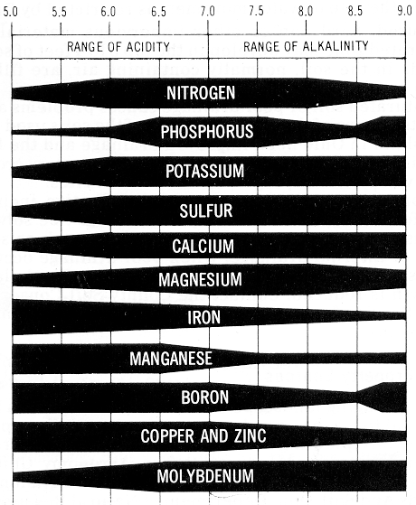
SOIL pH & NUTRIENT AVAILABILITY: mineral soils
6.5 maximizes
availability

Slide 39
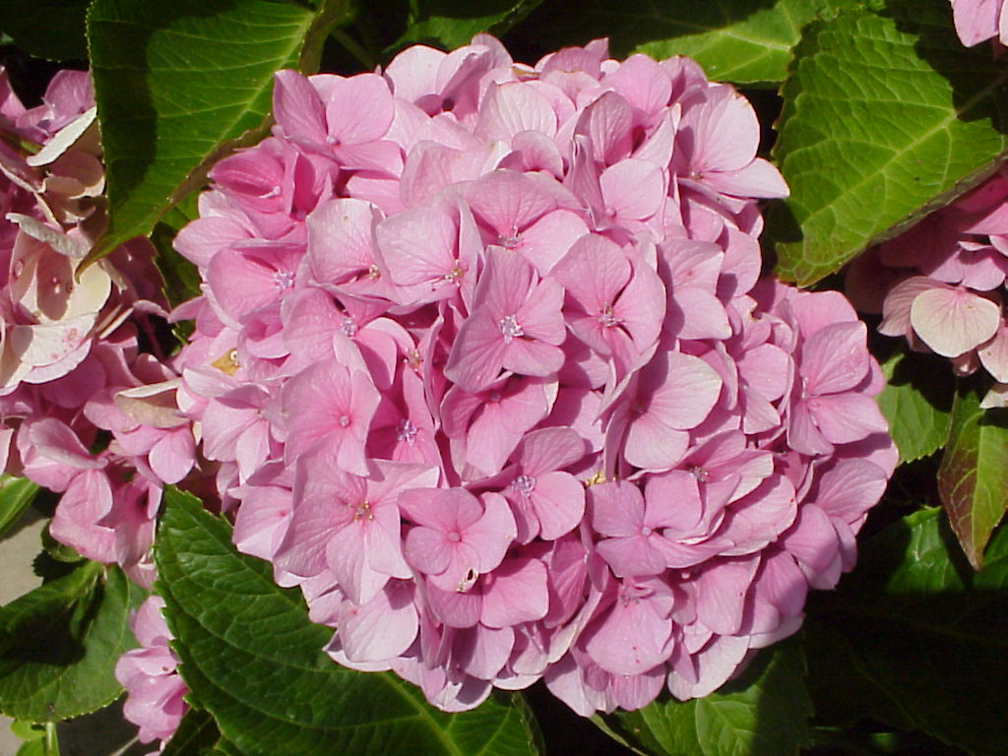
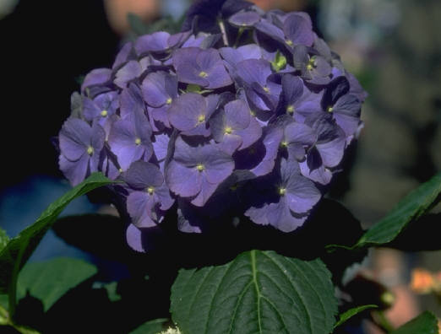
What Does The Hydrangea Tell You about the pH of the Soil?
Notes:
Presenter: Discuss the effect of soil pH on the color of hydrangea flowers.
[At a low or acid pH, aluminum is available to the plant and the flowers are blue. At a high or alkaline pH, aluminum is tied up and not available to the plant and the flowers are pink. Adding aluminum sulfate (or other acidifying materials) lowers the pH and provides additional aluminum which will result in blue flowers.]

Slide 40
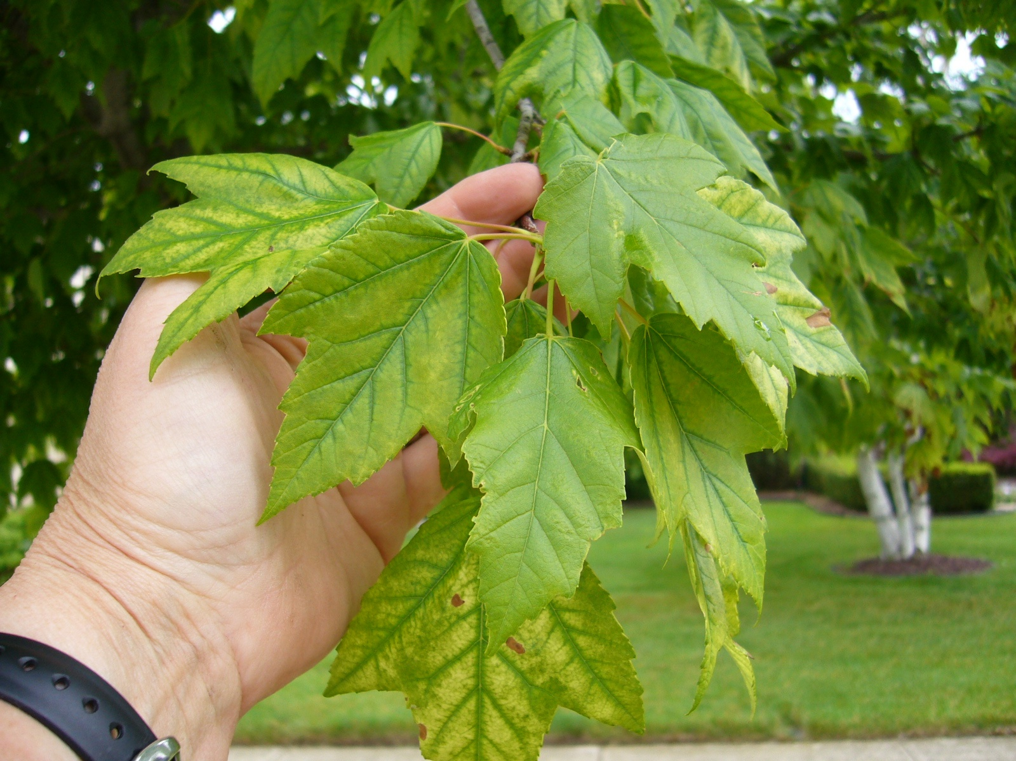
What Does This Tree Tell You about the pH of the Soil?
Notes:
Presenter: Discuss the effect of pH on iron availability and resulting chlorosis in pin oak and other species such as this red maple. Note that the chlorosis is present on new growth which may indicate that the nutrient in question is not mobile in the plant.
(Although iron is readily available in the soil, a high pH, 6.5 or above, prevents it from being available to the plant, resulting in chlorosis or yellowing. This is a common problem with pin oaks in Eastern Michigan where our soils typically have a pH higher than 6.5.)

Slide 41
When should a soil test be performed?
Any new construction.
Or, whenever the existing vegetation is torn up and re-seeded.

Slide 42
Soil Test When:
Every three years on existing sites
Helps insure pH and nutrient levels are appropriate to maintain a healthy growing environment.

Slide 43
MSU Extension Soil Testing Services
Soil Test mailer available for sale at MSUE Bookstore: bookstore.msue.msu.edu

Slide 44
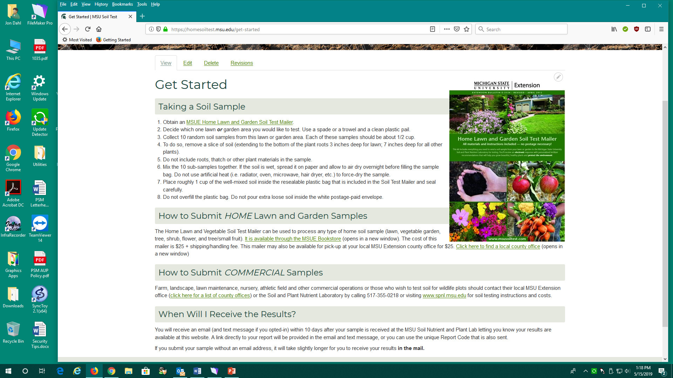

Slide 45
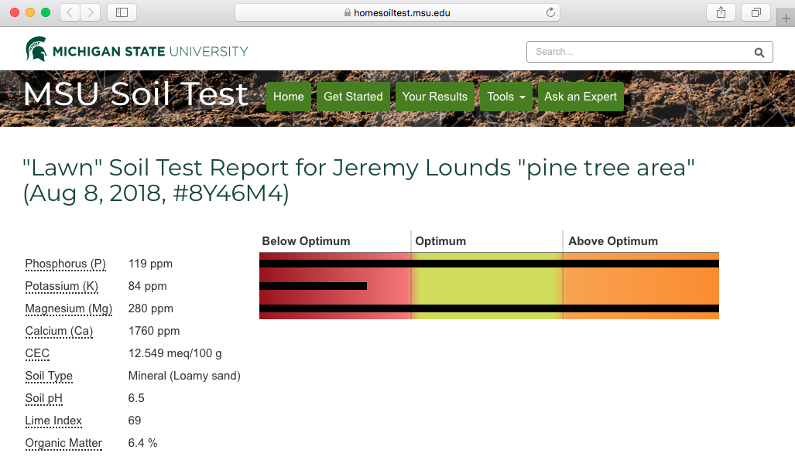
Website: homesoiltest.msu.edu

Slide 47
Smart Fertilizer Application
Slow release fertilizers
Split fertilizer applications
Maintaining buffer zones near water sources

Slide 48
Questions???????????
Jon Dahl
(517) 355-0218 or dahl@msu.edu
Lab Website: www.psm.msu.edu/SPNL

